Slide 1


Data Modification & Security Fundamentals
<Practice with DML and security fundamentals>

Slide 2


The task has been prepared by Yevhen Yermolenko

Slide 3
Data Modification
<Let’s explore common data modifications commands>

Slide 4
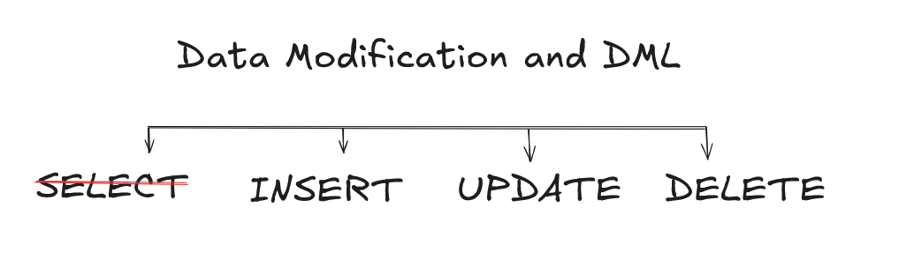
Data modification

Slide 5
Data modification
INSERT
INSERT operation adds new record to the table

Slide 6
Data modification
INSERT
INSERT operation adds new record to the table
You can specify the columns and values explicitly

Slide 7
Data modification
INSERT
INSERT operation adds new record to the table
You can specify the columns and values explicitly
All constraints might be taken into an account

Slide 8
Data modification
Samples:
INSERT
INSERT INTO customers
VALUES (1, ‘Yevhen’, ‘Yermolenko’, ‘mail@gmail.com’, ‘0501234567’, ‘Vinnytsia, Soborna, 1’);

Slide 9
Data modification
Samples:
INSERT
INSERT INTO customers
VALUES (1, ‘Yevhen’, ‘Yermolenko’, ‘mail@gmail.com’, ‘0501234567’, ‘Vinnytsia, Soborna, 1’);
INSERT INTO customers (first_name, last_name)
VALUES ( ‘Yevhen’, ‘Yermolenko’);

Slide 10
Data modification
Samples:
INSERT
INSERT INTO customers
VALUES (1, ‘Yevhen’, ‘Yermolenko’, ‘mail@gmail.com’, ‘0501234567’, ‘Vinnytsia, Soborna, 1’);
INSERT INTO customers (first_name, last_name)
VALUES ( ‘Yevhen’, ‘Yermolenko’);
INSERT INTO customers (first_name, last_name)
VALUES
( ‘Yevhen’, ‘Yermolenko’),
(‘Taras’, ‘Shevchenko’),
(‘Pes’, ‘Patron’);

Slide 11
Data modification
Samples:
INSERT
INSERT INTO customers
VALUES (1, ‘Yevhen’, ‘Yermolenko’, ‘mail@gmail.com’, ‘0501234567’, ‘Vinnytsia, Soborna, 1’);
INSERT INTO customers (first_name, last_name)
VALUES ( ‘Yevhen’, ‘Yermolenko’);
INSERT INTO customers (first_name, last_name)
VALUES
( ‘Yevhen’, ‘Yermolenko’),
(‘Taras’, ‘Shevchenko’),
(‘Pes’, ‘Patron’);
INSERT INTO customers (first_name, last_name)
SELECT e.first_name, e.last_name FROM employees e WHERE e.last_name = ‘Yermolenko’;

Slide 12
Data modification
Samples:
CREATE TABLE customers (
id SERIAL PRIMARY KEY,
first_name VARCHAR(50) NOT NULL,
last_name VARCHAR(50) NOT NULL,
email VARCHAR(100) UNIQUE NOT NULL,
phone VARCHAR(20) UNIQUE NOT NULL,
address TEXT NOT NULL,
created_at TIMESTAMP DEFAULT CURRENT_TIMESTAMP
);
INSERT

Slide 13
Data modification
Samples:
CREATE TABLE customers (
id SERIAL PRIMARY KEY,
first_name VARCHAR(50) NOT NULL,
last_name VARCHAR(50) NOT NULL,
email VARCHAR(100) UNIQUE NOT NULL,
phone VARCHAR(20) UNIQUE NOT NULL,
address TEXT NOT NULL,
created_at TIMESTAMP DEFAULT CURRENT_TIMESTAMP
);
INSERT
INSERT INTO customers (first_name, last_name)
VALUES ('Yevhen', 'Yermolenko');

Slide 14
Data modification
Samples:
CREATE TABLE customers (
id SERIAL PRIMARY KEY,
first_name VARCHAR(50) NOT NULL,
last_name VARCHAR(50) NOT NULL,
email VARCHAR(100) UNIQUE NOT NULL,
phone VARCHAR(20) UNIQUE NOT NULL,
address TEXT NOT NULL,
created_at TIMESTAMP DEFAULT CURRENT_TIMESTAMP
);
INSERT
INSERT INTO customers (first_name, last_name)
VALUES ('Yevhen', 'Yermolenko');
[23502] ERROR: null value in column "email" of relation "customers" violates not-null constraint
Detail: Failing row contains (1, Yevhen, Yermolenko, null, null, null, 2025-03-23 16:13:05.15775)

Slide 15
Data modification
Samples:
CREATE TABLE customers (
id SERIAL PRIMARY KEY,
first_name VARCHAR(50) NOT NULL,
last_name VARCHAR(50) NOT NULL,
email VARCHAR(100) UNIQUE NOT NULL,
phone VARCHAR(20) UNIQUE NOT NULL,
address TEXT NOT NULL,
created_at TIMESTAMP DEFAULT CURRENT_TIMESTAMP
);
INSERT
INSERT INTO customers (first_name, last_name, email, phone, address)
VALUES ('Yevhen', 'Yermolenko', 'email@e.com', '911', 'Vinnytsia');

Slide 16
Data modification
Samples:
CREATE TABLE customers (
id SERIAL PRIMARY KEY,
first_name VARCHAR(50) NOT NULL,
last_name VARCHAR(50) NOT NULL,
email VARCHAR(100) UNIQUE NOT NULL,
phone VARCHAR(20) UNIQUE NOT NULL,
address TEXT NOT NULL,
created_at TIMESTAMP DEFAULT CURRENT_TIMESTAMP
);
INSERT
INSERT INTO customers (first_name, last_name, email, phone, address)
VALUES ('Yevhen', 'Yermolenko', 'email@e.com', '911', 'Vinnytsia');
INSERT INTO customers (id, first_name, last_name, email, phone, address)
VALUES (1, 'Taras', 'Shevchenko', 't@e.com', 'n/a', 'Moryntsi');

Slide 17
Data modification
The data types smallserial, serial and bigserial are not true types,
but merely a notational convenience for creating unique
identifier columns (similar to the AUTO_INCREMENT).
Samples:
CREATE TABLE customers (
id SERIAL PRIMARY KEY,
first_name VARCHAR(50) NOT NULL,
last_name VARCHAR(50) NOT NULL,
email VARCHAR(100) UNIQUE NOT NULL,
phone VARCHAR(20) UNIQUE NOT NULL,
address TEXT NOT NULL,
created_at TIMESTAMP DEFAULT CURRENT_TIMESTAMP
);
INSERT
INSERT INTO customers (first_name, last_name, email, phone, address)
VALUES ('Yevhen', 'Yermolenko', 'email@e.com', '911', 'Vinnytsia');
INSERT INTO customers (id, first_name, last_name, email, phone, address)
VALUES (1, 'Taras', 'Shevchenko', 't@e.com', 'n/a', 'Moryntsi');
[23505] ERROR: duplicate key value violates unique constraint "customers_pkey"
Detail: Key (id)=(1) already exists.

Slide 18
Data modification
Samples:
CREATE TABLE customers (
id SERIAL PRIMARY KEY,
first_name VARCHAR(50) NOT NULL,
last_name VARCHAR(50) NOT NULL,
email VARCHAR(100) UNIQUE NOT NULL,
phone VARCHAR(20) UNIQUE NOT NULL,
address TEXT NOT NULL,
created_at TIMESTAMP DEFAULT CURRENT_TIMESTAMP
);
INSERT
INSERT INTO customers (first_name, last_name, email, phone, address)
VALUES ('Yevhen', 'Yermolenko', 'email@e.com', '911', 'Vinnytsia');
INSERT INTO customers (id, first_name, last_name, email, phone, address)
VALUES (1, 'Taras', 'Shevchenko', 't@e.com', 'n/a', 'Moryntsi’)
ON CONFLICT DO NOTHING;
NOT RECOMMENDED

Slide 19
Data modification
Samples:
CREATE TABLE customers (
id SERIAL PRIMARY KEY,
first_name VARCHAR(50) NOT NULL,
last_name VARCHAR(50) NOT NULL,
email VARCHAR(100) UNIQUE NOT NULL,
phone VARCHAR(20) UNIQUE NOT NULL,
address TEXT NOT NULL,
created_at TIMESTAMP DEFAULT CURRENT_TIMESTAMP
);
INSERT
INSERT INTO customers (first_name, last_name, email, phone, address)
VALUES ('Yevhen', 'Yermolenko', 'email@e.com', '911', 'Vinnytsia');
INSERT INTO customers (id, first_name, last_name, email, phone, address)
VALUES (1, 'Taras', 'Shevchenko', 't@e.com', 'n/a', 'Moryntsi’)
ON CONFLICT (id)
DO UPDATE SET address = ‘Moryntsi';

Slide 20
Data modification
Samples:
CREATE TABLE customers (
id SERIAL PRIMARY KEY,
first_name VARCHAR(50) NOT NULL,
last_name VARCHAR(50) NOT NULL,
email VARCHAR(100) UNIQUE NOT NULL,
phone VARCHAR(20) UNIQUE NOT NULL,
address TEXT NOT NULL,
created_at TIMESTAMP DEFAULT CURRENT_TIMESTAMP
);
INSERT
INSERT INTO customers (first_name, last_name, email, phone, address)
VALUES ('Yevhen', 'Yermolenko', 'email@e.com', '911', 'Vinnytsia');
INSERT INTO customers (id, first_name, last_name, email, phone, address)
VALUES (1, 'Taras', 'Shevchenko', 't@e.com', 'n/a', 'Moryntsi’)
ON CONFLICT (id)
DO UPDATE SET address = ‘Moryntsi'
RETURNING id, first_name, last_name;

Slide 21
Data modification
Samples:
CREATE TABLE customers (
id SERIAL PRIMARY KEY,
first_name VARCHAR(50) NOT NULL,
last_name VARCHAR(50) NOT NULL,
email VARCHAR(100) UNIQUE NOT NULL,
phone VARCHAR(20) UNIQUE NOT NULL,
address TEXT NOT NULL,
created_at TIMESTAMP DEFAULT CURRENT_TIMESTAMP
);
INSERT
INSERT INTO customers (first_name, last_name, email, phone, address)
VALUES ('Yevhen', 'Yermolenko', 'email@e.com', '911', 'Vinnytsia');
INSERT INTO customers (id, first_name, last_name, email, phone, address)
VALUES (1, 'Taras', 'Shevchenko', 't@e.com', 'n/a', 'Moryntsi’)
ON CONFLICT (id)
DO UPDATE SET first_name = 'Taras', last_name = 'Shevchenko’ RETURNING id INTO conflict_logs;

Slide 22
Data modification
Samples:
Enterprise insertion script example
INSERT
DO $$
DECLARE customer_exists INT;
BEGIN
SELECT COUNT(*) INTO customer_exists FROM customers WHERE id = 1;
IF customer_exists > 0 THEN
RAISE NOTICE 'Conflict detected: Employee ID already exists. Rolling back transaction.';
ELSE
INSERT INTO customers (id, first_name, last_name, email, phone, address)
VALUES (1, 'Taras', 'Shevchenko', 't@e.com', 'n/a', 'Moryntsi');
RAISE NOTICE 'Insert successful. Committing transaction.';
END IF;
END $$;

Slide 23
Data modification
INSERT
INSERT INTO
vs
SELECT INTO

Slide 24
Data modification
INSERT
INSERT INTO
vs
SELECT INTO
INSERT INTO adds a new row to the existing table

Slide 25
Data modification
INSERT
INSERT INTO
vs
SELECT INTO
INSERT INTO adds a new row to the existing table
SELECT INTO creates a new table and populates it with data from an existing table base on the SELECT query.

Slide 26
Data modification
INSERT
SUMMARY:
Use DEFAULT values for missing columns
Validate data types before inserting
Handle duplicate keys with ON CONFLICT
Use Transactions for bulk inserts to ensure atomicity

Slide 27
Data modification
The UPDATE command allows you to modify data in existing rows based on specific conditions
INSERT
UPDATE

Slide 28
Data modification
The UPDATE command allows you to modify data in existing rows based on specific conditions
INSERT
UPDATE
The ALTER TABLE allows you to change the structure of an existing table, such as adding new columns or modifying data types

Slide 29
Data modification
The UPDATE command allows you to modify data in existing rows based on specific conditions
INSERT
UPDATE
The ALTER TABLE allows you to change the structure of an existing table, such as adding new columns or modifying data types
Concurrent updates might result in Lost Updates Phenomena, use optimistic or pessimistic locking if needed

Slide 30
Data modification
The UPDATE command allows you to modify data in existing rows based on specific conditions
INSERT
The ALTER TABLE allows you to change the structure of an existing table, such as adding new columns or modifying data types
UPDATE
Concurrent updates might result in Lost Updates Phenomena, use optimistic or pessimistic locking if needed
Updates on large tables and on heavily indexed columns can decrease performance.

Slide 31
Data modification
The UPDATE command allows you to modify data in existing rows based on specific conditions
INSERT
The ALTER TABLE allows you to change the structure of an existing table, such as adding new columns or modifying data types
UPDATE
Concurrent updates might result in Lost Updates Phenomena, use optimistic or pessimistic locking if needed
Updates on large tables and on heavily indexed columns can decrease performance.
Complex data types must be updated with a proper update.

Slide 32
Data modification
Samples:
UPDATE customers
SET first_name = ‘YEVHEN’,
last_name = ‘YERMOLENKO’
WHERE id = 1;
INSERT
UPDATE

Slide 33
Data modification
Samples:
CREATE TABLE accounts (
id SERIAL PRIMARY KEY,
customer_id INT NOT NULL,
balance DECIMAL(15, 2) NOT NULL DEFAULT 0.00,
FOREIGN KEY (customer_id) REFERENCES customers (id) ON DELETE CASCADE
);
INSERT
UPDATE

Slide 34
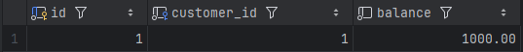
Data modification
Samples:
INSERT
UPDATE

Slide 35
Data modification
Samples:
INSERT
UPDATE accounts SET balance = 500
WHERE id = 10;
UPDATE

Slide 36
Data modification
Samples:
INSERT
UPDATE accounts SET balance = 500
WHERE id = 10;
UPDATE
Update is successful but affects 0 rows. It might be a silent failure

Slide 37
Data modification
Samples:
INSERT
UPDATE accounts SET balance = 500
WHERE id = 10;
UPDATE
Update is successful but affects 0 rows. It might be a silent failure
Check row count after update in application logic

Slide 38
Data modification
Samples:
INSERT
UPDATE accounts SET balance = 500;
UPDATE

Slide 39

Data modification
Samples:
INSERT
UPDATE accounts SET balance = 500;
UPDATE
[2025-03-23 20:16:56] Unsafe query: 'Update' statement without 'where' updates all table rows at once

Slide 40
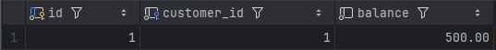
Data modification
Samples:
INSERT
UPDATE accounts SET balance = 500;
UPDATE
[2025-03-23 20:16:56] Unsafe query: 'Update' statement without 'where' updates all table rows at once

Slide 41
Data modification
Samples:
INSERT
UPDATE accounts SET balance = 500;
UPDATE
[2025-03-23 20:16:56] Unsafe query: 'Update' statement without 'where' updates all table rows at once
- Use update inside transaction;
- First run SELECT with the same WHERE condition to verify affected rows.

Slide 42
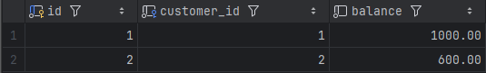
Data modification
Samples:
INSERT
UPDATE

Slide 43
Data modification
Samples:
INSERT
UPDATE
UPDATE accounts
SET balance = (SELECT balance FROM accounts WHERE id < 10);

Slide 44
Data modification
Samples:
INSERT
UPDATE
UPDATE accounts
SET balance = (SELECT balance FROM accounts WHERE id < 10);
[21000] ERROR: more than one row returned by a subquery used as an expression

Slide 45
Data modification
Samples:
INSERT
UPDATE
UPDATE accounts
SET balance = (SELECT AVG(balance) FROM accounts WHERE id < 10)
WHERE id < 10;

Slide 46
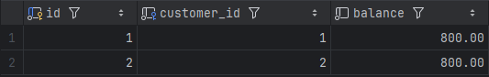
Data modification
Samples:
INSERT
UPDATE
UPDATE accounts
SET balance = (SELECT AVG(balance) FROM accounts WHERE id < 10)
WHERE id < 10;

Slide 47
Data modification
INSERT
SUMMARY
Always use WHERE with UPDATE
Do UPDATE inside transactions
Do updates in batches for large amount of data
Use SELECT to check condition before executing UPDATE
Use proper updates for complex data structures:
… SET data = jsonb_set(data, ‘{balance}’, ‘100’) …
UPDATE

Slide 48
Data modification
INSERT
The DB will locate the rows to be deleted matching the WHERE condition by available indexes or table scans, check constraints violation, place locks
Step 2
UPDATE
DELETE

Slide 49
Data modification
INSERT
The DB will locate the rows to be deleted matching the WHERE condition by available indexes or table scans, check constraints violation, place locks
Step 2
UPDATE
Every delete operation generates transaction log records to ensure consistency
DELETE

Slide 50
Data modification
INSERT
The DB will locate the rows to be deleted matching the WHERE condition by available indexes or table scans, check constraints violation, place locks
Step 2
UPDATE
Every delete operation generates transaction log records to ensure consistency
DELETE
The DB add different level locks on specific rows to prevent concurrent modifications

Slide 51
Data modification
INSERT
The DB will locate the rows to be deleted matching the WHERE condition by available indexes or table scans, check constraints violation, place locks
Step 2
UPDATE
Every delete operation generates transaction log records to ensure consistency
DELETE
The DB add different level locks on specific rows to prevent concurrent modifications
When rows are deleted, each index must be updated

Slide 52
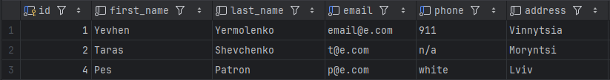
Data modification
Samples:
INSERT
Step 2
UPDATE
DELETE

Slide 53
Data modification
Samples:
INSERT
Step 2
UPDATE
DELETE FROM customers WHERE id = 123;
DELETE

Slide 54
Data modification
Samples:
INSERT
Step 2
UPDATE
DELETE FROM customers WHERE id = 123;
DELETE
Delete runs without errors but affects 0 rows. It might be a silent failure

Slide 55
Data modification
Samples:
INSERT
Step 2
UPDATE
DELETE FROM customers WHERE id = 123;
DELETE
Delete runs without errors but affects 0 rows. It might be a silent failure
Check affected row count or use RETURNING

Slide 56
Data modification
Samples:
INSERT
Step 2
UPDATE
DELETE FROM customers;
DELETE

Slide 57

Data modification
Samples:
INSERT
Step 2
UPDATE
DELETE FROM customers;
DELETE

Slide 58
Data modification
Samples:
INSERT
Step 2
UPDATE
DELETE

Slide 59
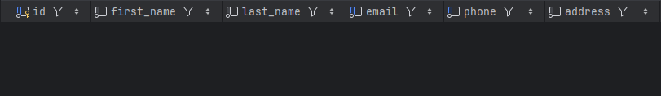
Data modification
Samples:
INSERT
Step 2
UPDATE
DELETE FROM customers;
DELETE

Slide 60
Data modification
Samples:
INSERT
Step 2
UPDATE
DELETE FROM customers;
DELETE
Use DELETE inside transaction;
Run SELECT first to check the condition

Slide 61
Data modification
Samples:
DELETE on large tables in batches:
DELETE FROM customers WHERE created_at < ‘2024-03-03’ LIMIT 1000;
INSERT
Step 2
UPDATE
DELETE

Slide 62
Data modification
Samples:
DELETE on large tables in batches:
DELETE FROM customers WHERE created_at < ‘2024-03-03’ LIMIT 1000;
INSERT
Step 2
DELETE for foreign keys:
ALTER TABLE customers ADD CONSTRAINT fk_user
FOREIGN KEY (user_id) REFERENCES users(id)
ON DELETE SET NULL;
UPDATE
DELETE

Slide 63
Data modification
Samples:
DELETE on large tables in batches:
DELETE FROM customers WHERE created_at < ‘2024-03-03’ LIMIT 1000;
INSERT
Step 2
DELETE for foreign keys:
ALTER TABLE customers ADD CONSTRAINT fk_user
FOREIGN KEY (user_id) REFERENCES users(id)
ON DELETE SET NULL;
UPDATE
DELETE
Lost Deletes prevention:
BEGIN TRANSACTION;
SELECT * FROM customers WHERE first_name = 'Yevhen' FOR UPDATE;
DELETE FROM customers WHERE first_name = 'Yevhen’;
COMMIT;

Slide 64
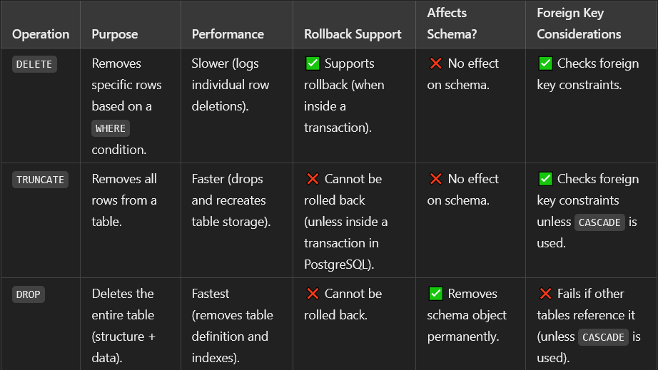
Data modification
INSERT
Step 2
UPDATE
DELETE

Slide 65
Data modification
INSERT
SUMMARY
Always use WHERE with DELETE
Do DELETE inside transactions
Do deletes in batches for large amount of data
Use SELECT to check condition before executing DELETE
Handle concurrency issues by locking rows before deletion
Use SOFT DELETE instead of physical deletion
Step 2
UPDATE
DELETE

Slide 66
Security Fundamentals

Slide 67
Security Fundamentals
Business requirements:
GDPR - General Data Protection Regulation

Slide 68
Security Fundamentals
Business requirements:
GDPR - General Data Protection Regulation
HIPAA - Health Insurance Portability and Accountability Act

Slide 69
Security Fundamentals
Business requirements:
GDPR - General Data Protection Regulation
HIPAA - Health Insurance Portability and Accountability Act
PCI-DSS - Payment Card Industry Data Security Standard

Slide 70
Security Fundamentals
PostgreSQL:
Authentication – who can access (password-based, Kerberos, certificate-based)

Slide 71
Security Fundamentals
PostgreSQL:
Authentication – who can access (password-based, Kerberos, certificate-based)
Authorization – what authenticated users can do (use least privilege principle)

Slide 72
Security Fundamentals
PostgreSQL:
Authentication – who can access (password-based, Kerberos, certificate-based)
Authorization – what authenticated users can do (use least privilege principle)
RBAC – role-based access control (grand roles to users or groups)

Slide 73
Security Fundamentals
PostgreSQL logging capabilities:
Connection attempts
SQL statements executed
Db object modifications (table creation, data inserts)
Administrative actions (role changes, config updates)
Error messages and warnings

Slide 74
Security Fundamentals
HAVE A BACKUP AND DISASTER RECOVERY PLAN

Slide 75
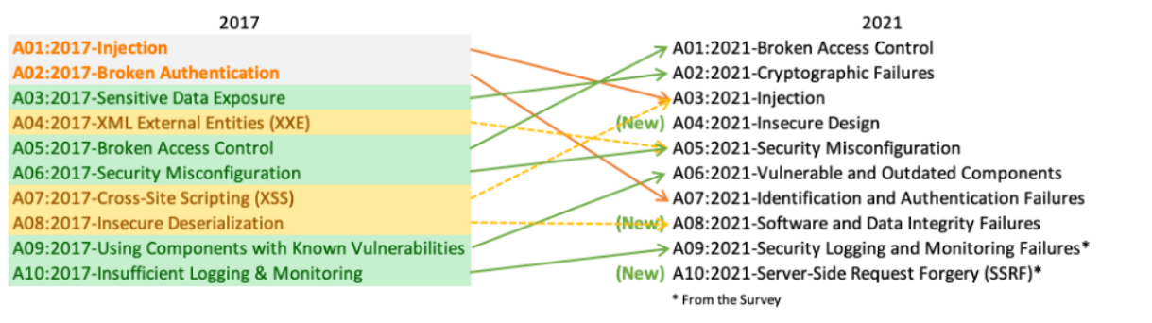
Security Fundamentals
OWASP top 10
https://owasp.org/www-project-top-ten/

Slide 76
Security Fundamentals
sql = "SELECT id FROM users WHERE username='" + user + "' AND password='" + pass + "'"

Slide 77
Security Fundamentals
sql = "SELECT id FROM users WHERE username='" + user + "' AND password='" + pass + "'"
pass' OR 1 = 1

Slide 78
Security Fundamentals
sql = "SELECT id FROM users WHERE username='" + user + "' AND password='" + pass + "'"
pass' OR 1 = 1
sql = "SELECT id FROM users WHERE username = 'user' AND password = 'pass' OR 1= 1"

Slide 79
Security Fundamentals
sql = "SELECT id FROM users WHERE username='" + user + "' AND password='" + pass + "'"
pass’ OR 1 = 1
sql = "SELECT id FROM users WHERE username = 'user' AND password = 'pass’ OR 1= 1"
Avoid concatenation. Use prepared statements.

Slide 80

Thank you
Author: Yevhen Yermolenko
My LinkedIn: https://www.linkedin.com/in/yerm/
March 2025
Join Codeus community in Discord
Join Codeus community in LinkedIn

